Slide 1


DEPI CAPSTONE PROJECT — INITIAL DRAFT
Supply Chain & Logistics Analytics
End-to-end performance tracking across product velocity, carrier efficiency, and supplier quality control.

Slide 2

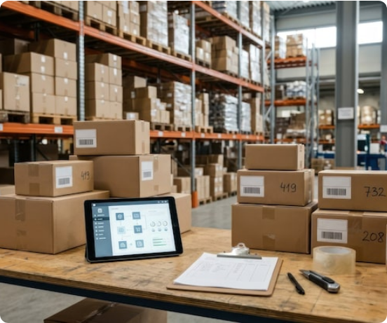
01 / PROJECT OVERVIEW
Business Problem & Scope
Eliminating operational blind spots across retail supply lines.
•
Cost Volatility: Unoptimized freight routes inflate shipping expenses.
•
Lead Time Delays: Inconsistent procurement cycles disrupt stock availability.
•
Quality Bottlenecks: Elevated defect rates reduce net profit margins.
•
Core Objective: Centralize KPIs inside an interactive Power BI dashboard.

Slide 3
02 / DATA SOURCE
Dataset Architecture
Comprehensive Fashion & Beauty startup supply chain records covering full SKU lifecycles.
100
24
3
5
Active SKUs
Key Variables
Product Lines
Supplier Hubs
Unique product records
End-to-end attributes
Skincare, Haircare, Cosmetics
Regional manufacturing centers

Slide 4
03 / WORKFLOW
Data Pipeline & Methodology
STEP 01
STEP 02
STEP 03
STEP 04
Data Ingestion
Quality Validation
Feature Creation
Visual Reporting
Import raw CSV records into Power Query.
Verify zero nulls across SKU identifiers.
Calculate net margins via custom DAX measures.
Build interactive executive Power BI views.

Slide 5
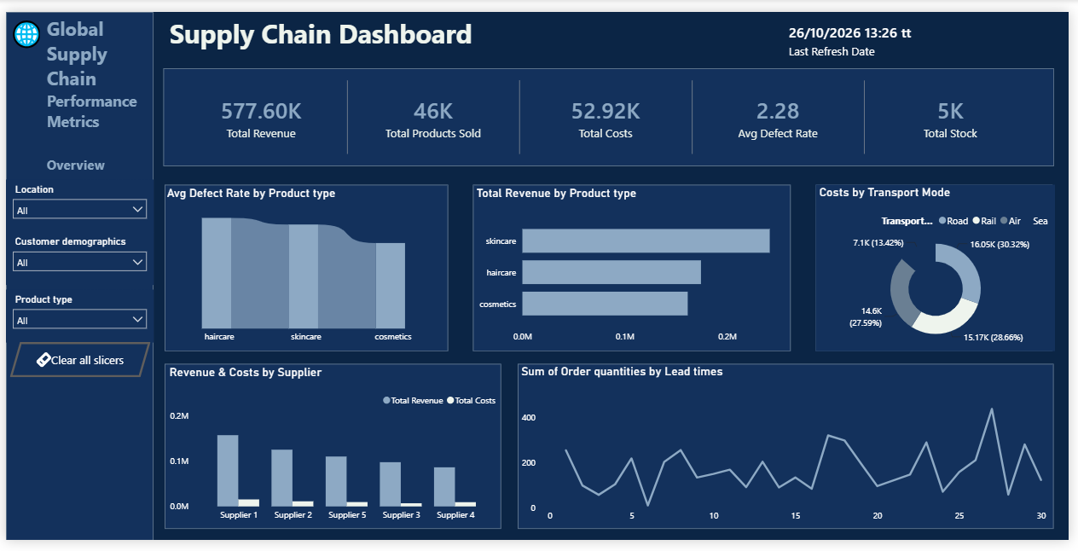
ANALYTICAL PILLAR 01
Sales & Revenue Performance
Evaluating product category contribution, unit velocity, and customer demand segmentation.

Slide 6
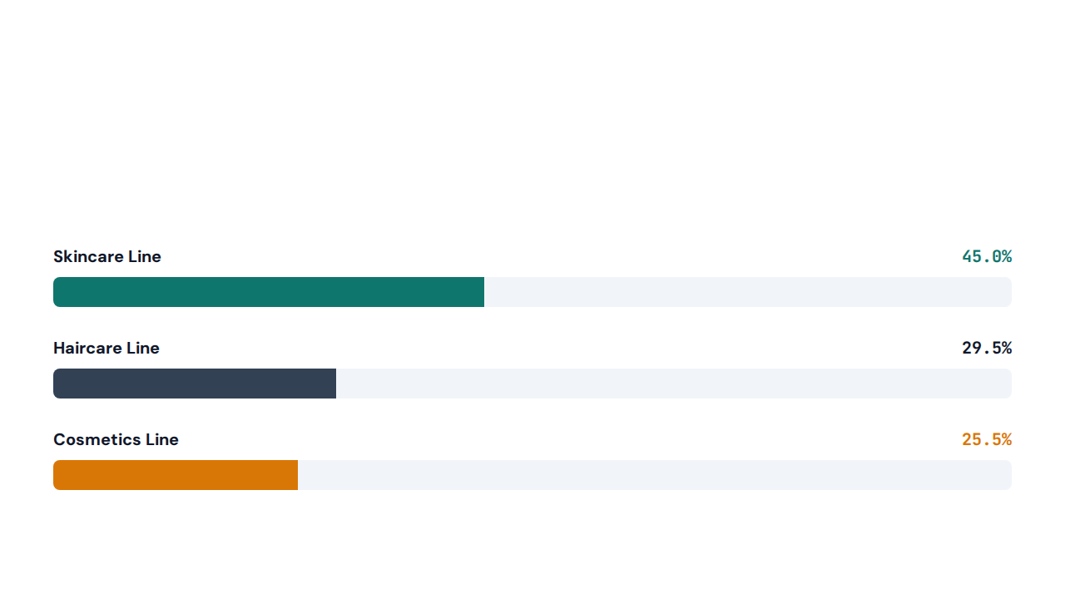
04 / CATEGORY BREAKDOWN
Revenue Share by Category
Skincare dominates overall business revenue across the 100-SKU portfolio.

Slide 7


05 / ANALYTICAL PILLAR 02
Logistics & Carrier Efficiency
Multi-Modal Freight Optimization
Evaluating transit times across Carrier A, Carrier B, and Carrier C over Road, Air, Rail, and Sea networks.
Routes A, B & C Tracked

Slide 8
06 / FREIGHT BENCHMARKING
Carrier & Transit Mode Matrix
Transit Mode | Primary Use Case | Cost Profile | Speed Rating | Optimization Focus
Road Freight | Regional hub distribution | Moderate | Fast | Route B consolidation
Air Freight | High-margin skincare SKUs | High | Express | Weight threshold caps
Rail Network | Bulk cross-city replenishment | Low | Standard | Schedule synchronization
Sea Cargo | High-volume base stock | Lowest | Extended | Lead time buffering

Slide 9
07 / ANALYTICAL PILLAR 03
Quality Control & Defect Rates
2.5%
Peak Average Defect Rate in Haircare Products
Requires stricter supplier inspection protocols across Mumbai and Kolkata hubs.

Slide 10



08 / DASHBOARD ARCHITECTURE
Core Power BI Dashboard KPIs
Revenue Velocity
Transit Cost Ratio
Defect Rate Index
Track top-selling SKU margins.
Optimize freight carrier selection.
Monitor supplier failure thresholds.

Slide 11
09 / STRATEGIC IMPACT
Optimization Roadmap
Current Operational Bottlenecks
Target Data-Driven Actions
•
Skincare Stockouts: High-demand SKUs face inventory shortages.
•
Dynamic Reordering: Align safety stock with SKU sales velocity.
•
Carrier Cost Spikes: Unbalanced allocation across Carrier B routes.
•
Route Rebalancing: Shift non-urgent freight to rail networks.
•
Failed Inspections: Elevated haircare damage during transit.
•
Supplier Audits: Enforce pre-shipment quality checks at source.

Slide 12
DIGITAL EGYPT PIONEERS INITIATIVE (DEPI)
Thank You & Next Steps
Final Power BI dashboard deployment and DAX model refinement in progress.

